Slide 1
Monthly Status Meeting

Slide 2
01st Jan 00 12:00
Click here to join the meeting
01st Jan 00 12:00 -13:00 HKT

Slide 3
Agenda
Projects Summary
Project 1 – Status Update
  Project 1 Summary
  Deployment Status & Change Request progress
  Incident Report
  Outstanding Incidents
  Other Projects – Status Update
AOB

Slide 4
Project Summary
(Period: 01Jan00 to 30Jan00)
Highlights
project support activity and CRs are going on as per agreed schedule (Detailed Slide)
Previous meeting Action points (15th Jan00) | Previous Target date | Status / Revised target
Incidents discussion Project Discussion |  | Ongoing Task

Slide 5
Maintenance items – Summary 2000
Quarter | Item | Status | Planned Date | Revised Date | Actual Date
Q1 | XXXX Health Check | Completed | 01Jan00 | 31Mar00
Q1 | XXX Task 1 | In Progress
Q1 | XXX Task 2 | Completed
Q2 | XXXX Health Check | In Progress
Q3 | XXXX Health Check | Completed
Q4 | XXXX Health Check

Slide 6
Maintenance items – Summary 000 (Contd.)
S No. | Action Plan | Description
1. | ACTION PLAN XXXX | XXXX
2
2.1
2.2
2.3
2.4
2.5

Slide 7
Maintenance items – Summary 0000

Slide 8
  PROJECT 1 Status Update

Slide 9
PROJECT1 - Deployment & Change Request progress
Deployment Update (01Jan00 to 31Jan00)
X NUMBER Deployments in Application during this period (X deployment in 01Jan, 1 deployment in 31jan)
These included – X fixes (10JAN00) –X fixes (10JAN00)

Slide 10

Monthly Statistics Analysis

Slide 11
Month wise Incidents Analysis

Slide 12
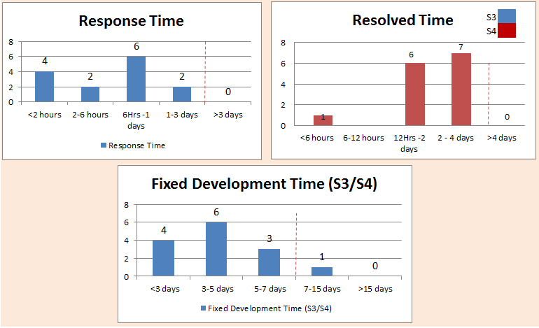
Resolution Statistics JAN’0000

Slide 13
KPI (Year 0000)
KPI in 0000 | 0000 (upto last month) | 0000 Target | 0000 Health
Number of A cases / number of deployment: x1/y , where: | XX | XX | G
2. Number of B cases / number of deployment: x2/y, where: |  | XX | G
3. No S1 and S2 incidents from CR / Bug fix: x3 |  | 0 | G
4. Timely RCA and Sharing with teams and BAs: within X days (with quarterly review)
- Number of RCA and sharing within X days: x4/z , where z = total number of RCA |  | XXX% | A
5. Average SR/data patch per month |  | XX | G
6. No of outstanding Invalid Incidents for discussion |  | <XX | G
7. No. of important operations incidents |  | XX | G
8. No. of "cannot replicate" valid incidents |  | XX | G
9. No. of outstanding valid side-walk bugs to be fixed |  | <XX | R
10 No. of problem and side-walk bugs issues for discussion |  | <XX | G

Slide 14
Outstanding Incidents
  Progress
  Summary of discussions
  No of Outstanding Incidents for discussion: XX
  The new incident added after last meeting: XX
Date | No of Incidents carry forwarded as per previous meeting | No of Incidents added new | Incidents cancelled | Incident under further investigation | Incidents accepted by vendor for fixing
XXXX | X | X | X | XX | X

Slide 15
Thank You

Slide 16
Daily status – for ongoing issues Template for Top management
Overall Status:
Red/Amber/Green
Key highlights:
Highlight/task1
Highlight/task2
Risks & Mitigation/ Dependencies:
Risk1
Risk2
S No | Task | Owner | Start Date | End Date | Status | Comments
 |  |  |  |  | WIP
 |  |  |  |  | Delay
 |  |  |  |  | Close

Slide 17
Project Workflow
Stakeholder Engagement
Functional Requirements Gathering
  Client stakeholders provide initial functional requirements.
Requirement Discussion
  Project Manager (myself), Business Analyst, and Team Member discuss the requirements with the operations team.
Documentation Creation
  Convert requirements into functional and non-functional requirements (NFR) documentation.

Slide 18
Project Workflow - Contd
Estimation and Quoting
Effort Estimation
  Vendor team estimates the effort required based on the documented requirements.
Quote Submission
  Submit the initial quote to the client stakeholders..
Negotiation and Finalization
  Finalize the quote after negotiations with the client.

Slide 19
Project Workflow - Contd
Project Award and Initiation
Project Award
  Receive Purchase Order (PO) from the client, officially awarding the project.
Project Kick-off
  Initiate the project and begin executing the following workflow steps.

Slide 20
Project Workflow - Contd
Project Timelines
  Final Design Documentation Submission Date
  Development Completion Dates
    (Dates for tactical and strategic solutions or phase-wise releases if applicable)
  Development Testing Dates
  User Acceptance Testing (UAT) Dates
  System Integration Testing (SIT) Date
  Proposed Production Deployment Date

Slide 21
Project Workflow - Contd
Delivrables & Other Activities
Issue Logging and Tracking
  Use bug-tracing systems for logging and tracking all issues.
Requirement Traceability Matrix
  Maintain a Requirement Traceability Matrix for all changes.
Impact Analysis Documentation
  Document the impact analysis for changes.
Known Issues
  Track and document all known issues.
Deployment Notes
  Include a short description of the new project and details of all production incident closure activities

